Slide 1
Design Patterns
Chapter 12

Slide 2
Compound Patterns
So what’s new?
  We’ve already used multiple patterns together
  Composite and Iterator
  Composite and Visitor
Nonetheless, let’s track the evolution of a (very unrealistic) project

Slide 3
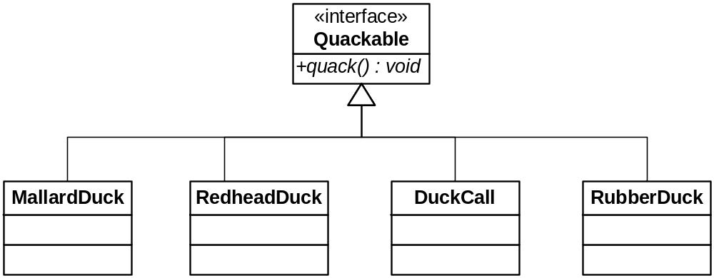
Rebuilding The Duck Simulator from Scratch

Slide 4
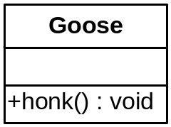
Some Geese Want To Join the Crowd
But how can they? They don’t quack. Oh, what to do!

Slide 5
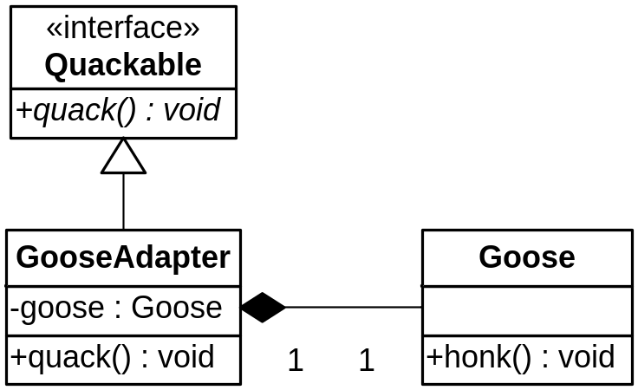
Adaptable Geese

Slide 6
Where we are so far…
We have:
  Adapter
Page 504
Bonus: What if we used Strategy?
  QuackBehavior…

Slide 7
Counting Quacks
The Quackologists want to count every quack
  But not honks!
So we want to add functionality
  But only to certain objects
How’s a good way to do it?

Slide 8
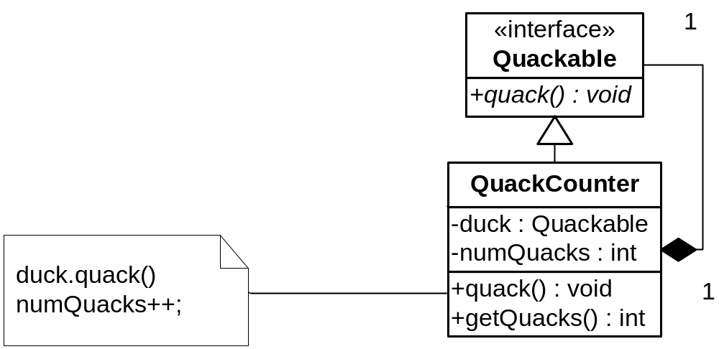
A QuackCounter Decorator

Slide 9
Counting Patterns…
We have
  Adapter
  Decorator
Pages 506-507

Slide 10
Problem
Not all the Ducks are being decorated
  The counts are off!
  Lazy programmers!
How can we automate the decorating of ducks?

Slide 11
Context
We want to create families of duck objects
We may want to decorate them or not
  Nice to have this flexibility
So we need an Abstract Factory
  For each set of duck families
  Counted vs. not
P. 508-511

Slide 12
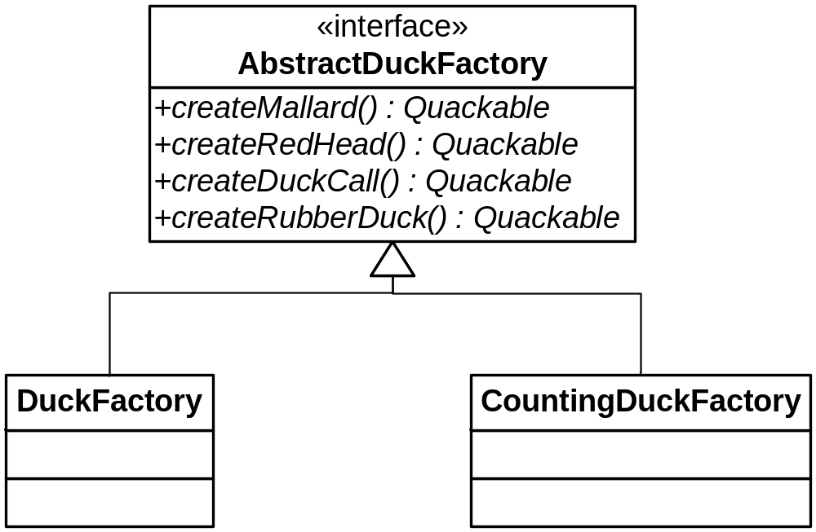
Duck Factories

Slide 13
What About the Geese?
They’re part of the flock
  Quackable gooseDuck = new GooseAdapter(new Goose());
The keyword is “flock”
  We want to have flock-wide operations
So we just put all these objects in a container and iterate
  The book used Composite, but that’s really stretching it
  I’ve had enough of this!

Slide 14
What Do We Have?
We have a bucket of patterns
Let’s look at a compound pattern: a pattern that consists of several patterns working together

Slide 15
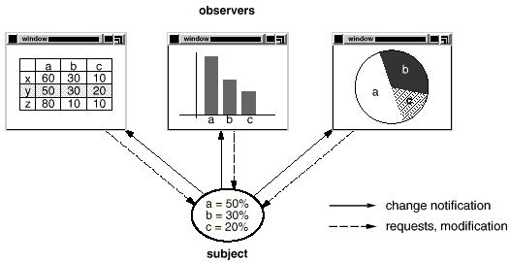
Remember this Picture?

Slide 16
Flexible GUI Design
An object (or set of objects) can be viewed in many ways
But they should be independent of those views
  So the views can be added or removed at will without disturbing the underlying object model

Slide 17
How Do Users Interact with an Object Model?
Users aren’t programmers, so they don’t call methods directly
Nor do they build GUI widgets
But their interaction with a GUI may change object state
  And all views should be updated accordingly

Slide 18
The Model
The functional core of an application
May consist of many related classes
Has no GUI knowledge
May use a database to store its data

Slide 19
The View(s)
Any component that displays information to the user is a View
Different Views can present data in different ways
They can be text or graphical
A View is an indirect observer of the model
  So it can be updated appropriately
  It doesn’t change the model! It pulls only.

Slide 20
GUI Views
GUI views typically have a parent frame that contains other GUI components
  Some of which are also containers
So they are often Composites
  For example, JFrame can hold other GUI containers…

Slide 21
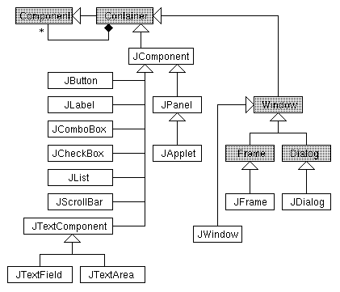
Java Swing Components

Slide 22
Remember the SRP?
What is the responsibility of a view?
To display
  Nothing else
  Definitely not to change the object model
Whose responsibility is it to track user input (that may change the model)?

Slide 23
The Controller(s)
Each view has an associated Controller
The Controller monitors user events and changes to the model, and updates the view
  Changes can also come from real-time updates from hardware, for example
The Controller is a View’s Strategy
  A View creates its Controller

Slide 24
Model-View-Controller
The Model is the functional core of the application
  Including related data
Views display information to the user
The View’s controller handles user input
  And observes the Model
  And keeps the View and Model in sync
The Views and Controllers together are the user interface

Slide 25
The User Interface
Views and Controllers are logically distinct, but are often packaged together
  For example, Swing components have listeners; these are part of the Controller

Slide 26
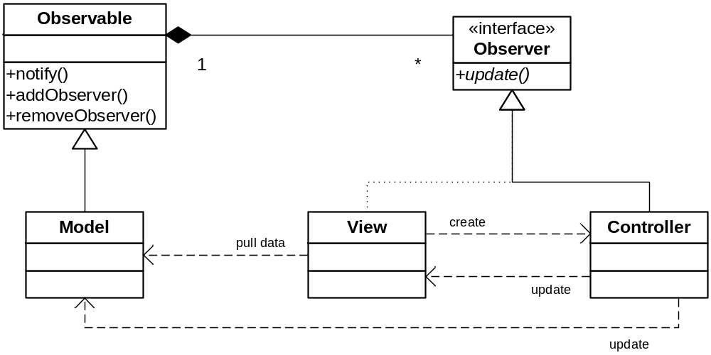
MVC at-a-glance

Slide 27
MVC as a Compound Pattern
Views are Composites
  And indirect Observers of their Model
  Their Controller notifies them
Controllers are Strategies for their View and Observers of their Model
Models are Observable subjects
Benefit: all can be swapped out!

Slide 28
MVC: Hard to Grok?
It usually is
The book is helpful: Pages 529-533 (or up to 547, if we get that far)
No dumb questions: P 559

Slide 29
Document View Architecture
From MFC
Collapses the View and Controller into the view
  The Model is still (mostly) stand-alone
Less flexible than MVC but often workable
  Can’t swap in a new Controller strategy
  Can’t reuse View independently
  Sometimes you don’t care
  You can still have multiple views for the model

Slide 30
Course Summary
A Pattern is a Solution to a Problem in a Context
  It strives to balance various forces present in a context
They follow good Design Principles
  And sometimes violate them!
Know the Principles!

